Slide 1
Changes are coming to HUSKY
Protect yourself
Notes:
How many have heard of the cuts coming to HUSKY?
Who does it affect?
When does it start?
What do you need to do?
I will share the answers we have so far. We know a lot more than we did this Spring, but still a lot to be worked out.

Slide 2
What‘s happening?
The Bad News
Healthcare for over 300,000 state residents is at risk
Estimate that most have chronic conditions
Across Connecticut, 100,000 people will become uninsured
Thousands more could lose care provided by their family and friends
The Good News
There are 14 ways to keep their healthcare
Many will keep their coverage automatically
For the others, there is help to sort this out

Slide 3
What‘s happening?
Medicaid = HUSKY in Connecticut
These are new federal requirements – states have to implement them
Only applies to HUSKY Part D members – ages 19 to 64, without children on HUSKY
HUSKY work requirements start as of January 1st
Have to
  Work, making $580/month, or
  Be in school or job training, at least half time, or
  Volunteer in your community, or a
  Combination of these that reaches 80 hours/month
There are also exemptions -- more on this later
Have to renew every 6 months, not annual anymore
That is 5,187 people in Hamden
Expect about half will be automatically renewed by the state
Notes:
The state will use information they already have, such as payroll records, school lists, medical records, etc. to exempt people automatically without them needing to do anything.
But for others, they may need documentation from the HUSKY member.
If they have updated contact info, they will send an individualized notice to let people know eactly what they need to do and how to do it.

Slide 4

How to know if you are on HUSKY Part D
Ages 19 to 64, without children on HUSKY
Will be on your HUSKY card
Log onto MyAccount at mydssct.ct.gov
Call HUSKY at 1-800-859-9889

Slide 5
Exemptions
Pregnant people
Caregiver for child under age 14
Caregiver for people with serious illness
Former foster youth, to age 26
In active recognized drug/alcohol treatment program
Current/formerly incarcerated
Medically frail, blind, or disabled people
Enrolled in Medicare
SNAP, TANF if you already comply with work requirements
Veteran with a total, 100% disability
Native American member of a tribe

Slide 6
Why do I need to worry?
(even if you’re not on HUSKY)
Estimate 137,000 more uninsured in Connecticut – highest rate in 20 years
Uninsured people tend to wait until conditions are harder and more expensive to treat
Don’t get care to maintain health and ability to work – becomes a cycle
Worse ED crowding and reduced services for everyone
Hospitals and providers don’t get paid, affects services
Medical debt, bankruptcy
Hurts your credit report for years – affects housing, school, loans
Loss of $118 billion to Connecticut in federal healthcare funding
Loss of 2,500 jobs in Connecticut, mostly in healthcare
Health services will have to close

Slide 7

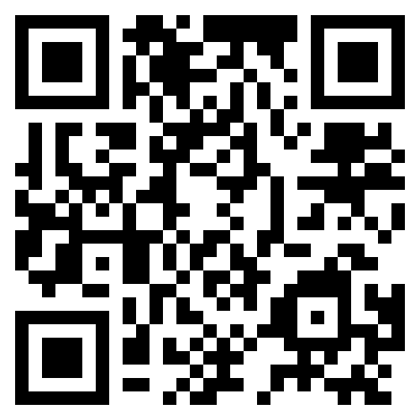
Update your contact info with DSS
ct.gov/updateusdss

Slide 8
Add new DSS numbers to your saved contacts
Messages on work requirements
1-959-246-3060
648731
Messages on general eligibility
1-855-626-6632
648731
Respond to communications from DSS right away

Slide 9
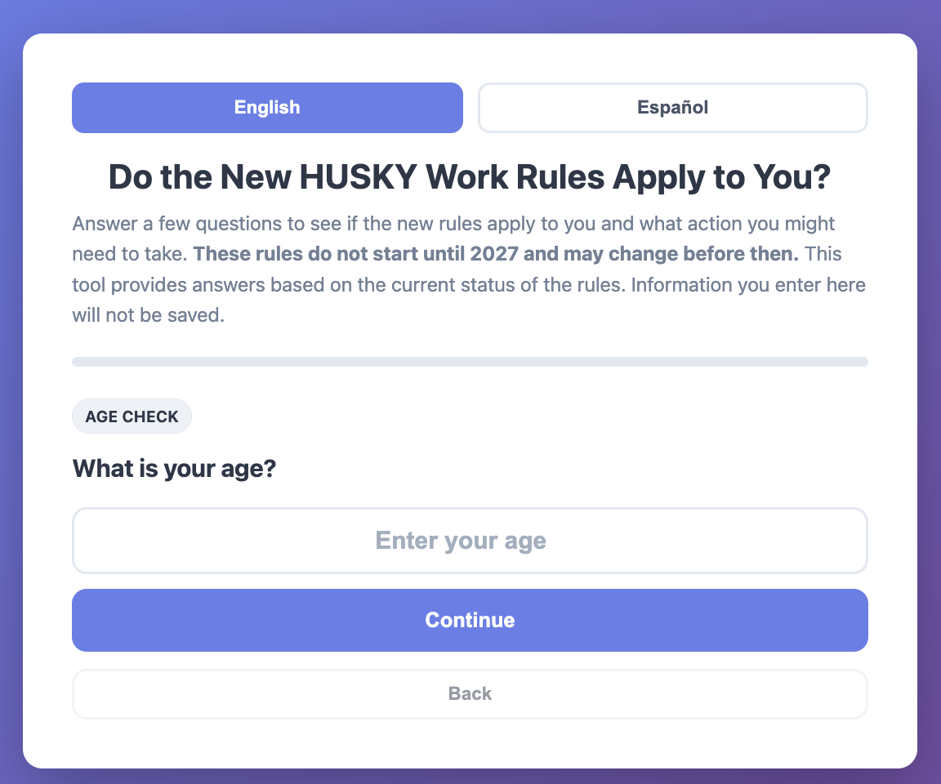
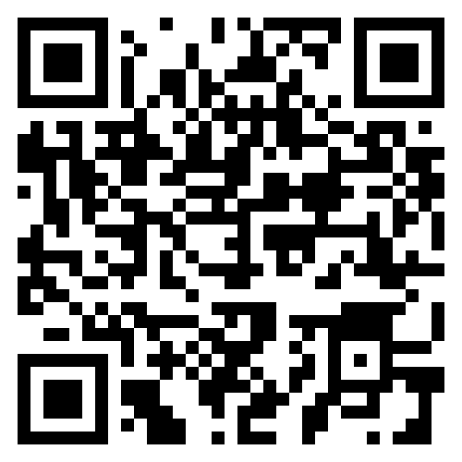
Do the changes apply to you?
ct.gov/upateusdss

Slide 10
Caregiving
The most common reason given by Connecticut Medicaid recipients for not working is caring for family.
Over 60,000 Connecticut adults with incomes under $25,000/year provide critical care for some one who can ‘t care for themselves
One in five caregivers has trouble taking care of their own health and only 38% are in excellent or very good health.
Two in five experience high emotional stress.
Almost half (42%) experience financial hardships due to their caregiving responsibilities including using up savings, taking on debt, and putting off retirement.
Many are likely covered by Medicaid.

Slide 11
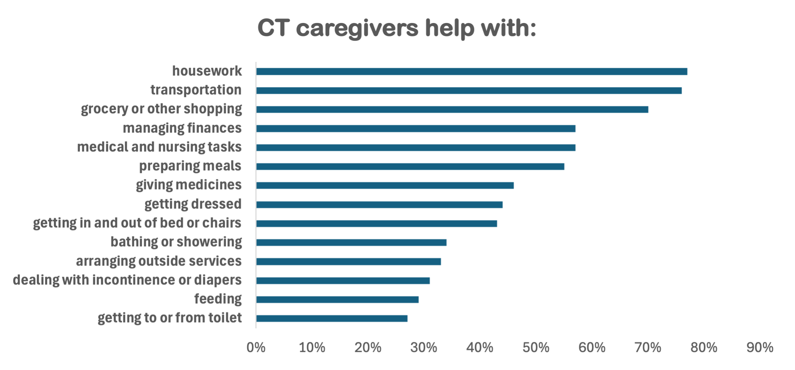
Caregiving qualification
Regular, ongoing care for someone who cannot care for themselves alone
Includes seniors, medical problems, mental health issues
Relative, living with the person, or provide 80 hours of care/month
If <80 hours, it can combine with work, school, or volunteer hours
Notes:
Source: HUSKY and Caregivers: Impact of Medicaid work requirements, CT Health Policy Project, https://cthealthpolicy.org/wp-content/uploads/2026/08/Caregiver-fact-sheet-to-share-online.pdf

Slide 12
Medical frailty exemption
People with serious medical problems and cannot work
Such as -- blind or disabled, alcohol/substance use disorder, disabling mental condition, disability, or serious/complex medical condition
PLUS
Condition must keep you from being able to work
DSS will qualify many based on medical records
If need documentation, people can self-attest through 2027
Lawsuit by states pending, includes CT

Slide 13
How to keep everyone covered
Update your contact info
Find out if you are affected
Respond to DSS messages quickly
Tell people about this
Update income with DSS

Slide 14
For help
CT Dept. of Social Services (DSS)
Medicaidmattersct.org
Find your local Community Action Agency
cafca.org/agencies
Access Health CT
Accesshealthct.com
1-855-805-4325

Slide 15
Helpful resources for HUSKY caregivers
CT Health Policy Project webpage
HUSKYcaregivers.org
Flyer in English, Spanish
Fact Sheet
Flowchart for caregiver exemption eligibility
and more

Slide 16

Questions

