Slide 1
Changes are coming to HUSKY
Protect yourself
Ellen Andrews
CT Health Policy Project
For Hamden Info Session
October 21 2026

Slide 2
What‘s happening?
The Bad News
Healthcare for 5,187 Hamden residents is at risk
Estimate that most have chronic conditions
Across Connecticut, 100,000 people likely to lose HUSKY
Thousands more could lose care provided by their family and friends
The Good News
There are 14 ways to keep your healthcare
Many will keep their coverage automatically
For the others, there is help to sort this out

Slide 3
What‘s happening?
Medicaid = HUSKY in Connecticut
These are new federal requirements – states have to implement them
Only applies to HUSKY Part D members – ages 19 to 64, without children on HUSKY
HUSKY work requirements start as of January 1st
Have to
  Work, making $580/month, or
  Be in school or job training, at least half time, or
  Volunteer in your community, or a
  Combination of these that reaches 80 hours/month
There are also exemptions -- more on this later
Have to renew every 6 months, not annual anymore
That is 5,187 people in Hamden
Expect about half will be automatically renewed by the state

Slide 4

How to know if you are on HUSKY Part D
Ages 19 to 64, without children on HUSKY
It’s on your HUSKY card
Log onto MyAccount at mydssct.ct.gov
Call HUSKY at 1-800-859-9889

Slide 5
Exemptions
Pregnant people
Caregiver for child under age 14
Caregiver for people with serious illness
Former foster youth, to age 26
In active recognized drug/alcohol treatment program
Current/formerly incarcerated
Medically frail, blind, or disabled people
Enrolled in Medicare
SNAP, TANF if you already comply with work requirements
Veteran with a total, 100% disability
Native American member of a tribe

Slide 6
Why do I need to worry?
(even if you’re not on HUSKY)
Changing time to pay medical bills from 3 months to 1 month from application
Uninsured people tend to wait until conditions are harder and more expensive to treat
Don’t get care to maintain health and ability to work – becomes a cycle
Worse ED crowding and reduced services for everyone
Hospitals and providers don’t get paid, raising premiums and taxes for everyone
Medical debt, bankruptcy
Hurts your credit report for years – affects housing, school, loans, jobs
Loss of $118 billion in federal healthcare funding
Loss of 2,500 jobs, mostly in healthcare
Health services will have to close

Slide 7

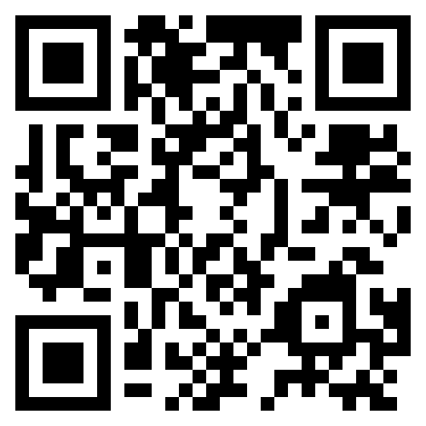
Update your contact info with DSS
ct.gov/updateusdss

Slide 8
Add new DSS numbers to your saved contacts
Messages on work requirements
1-959-246-3060
648731
Messages on general eligibility
1-855-626-6632
648731
Respond to communications from DSS right away

Slide 9
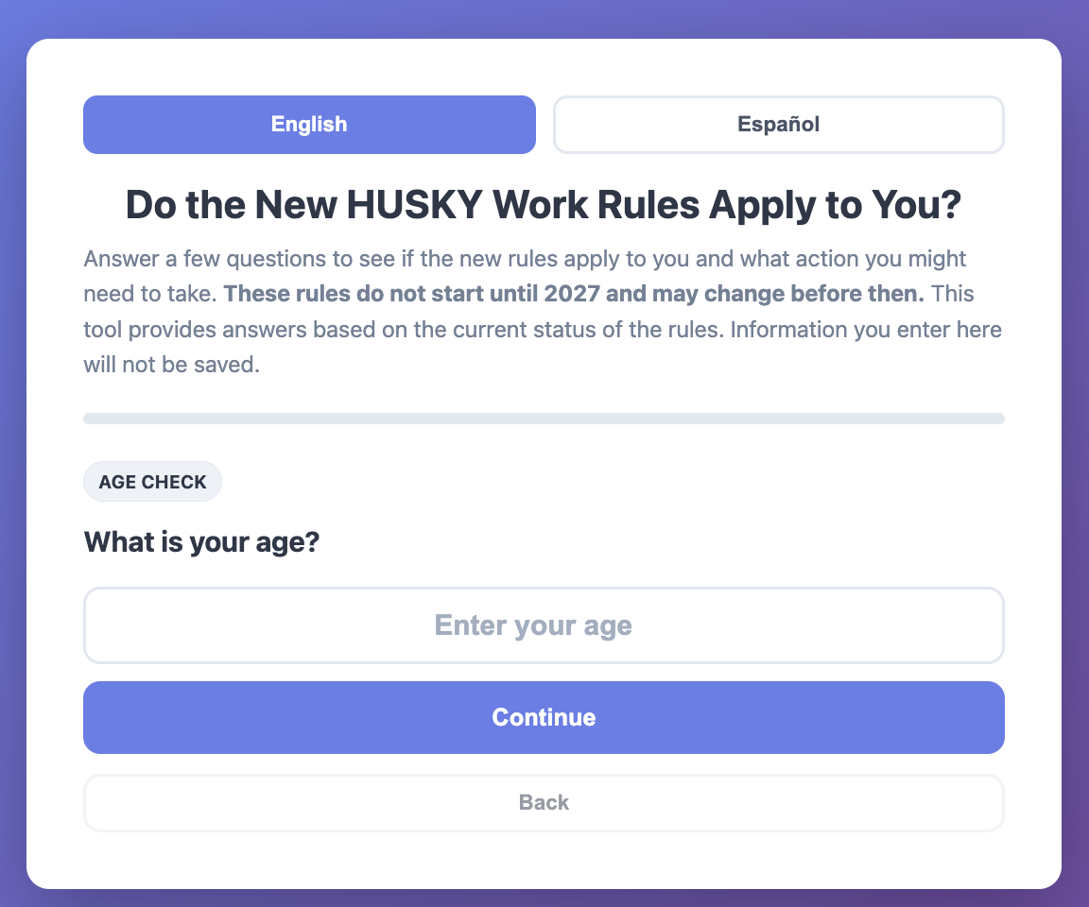
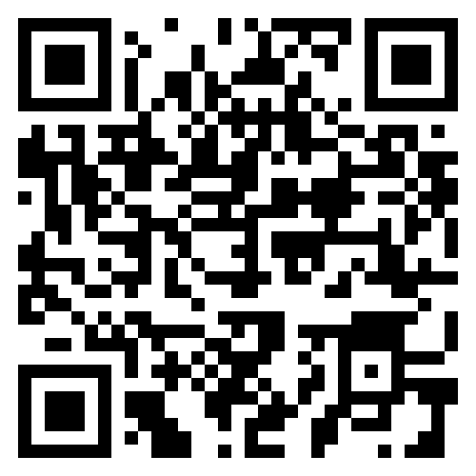
Do the changes apply to you?
ct.gov/upateusdss

Slide 10
Caregiving
The most common reason given by Connecticut Medicaid recipients for not working is caring for family.
Over 60,000 Connecticut adults with incomes under $25,000/year provide critical care for some one who can‘t care for themselves
One in five caregivers has trouble taking care of their own health and only 38% are in excellent or very good health.
Almost half experience financial hardships due to their caregiving responsibilities including using up savings, taking on debt, and putting off retirement.
Many are likely covered by Medicaid.

Slide 11
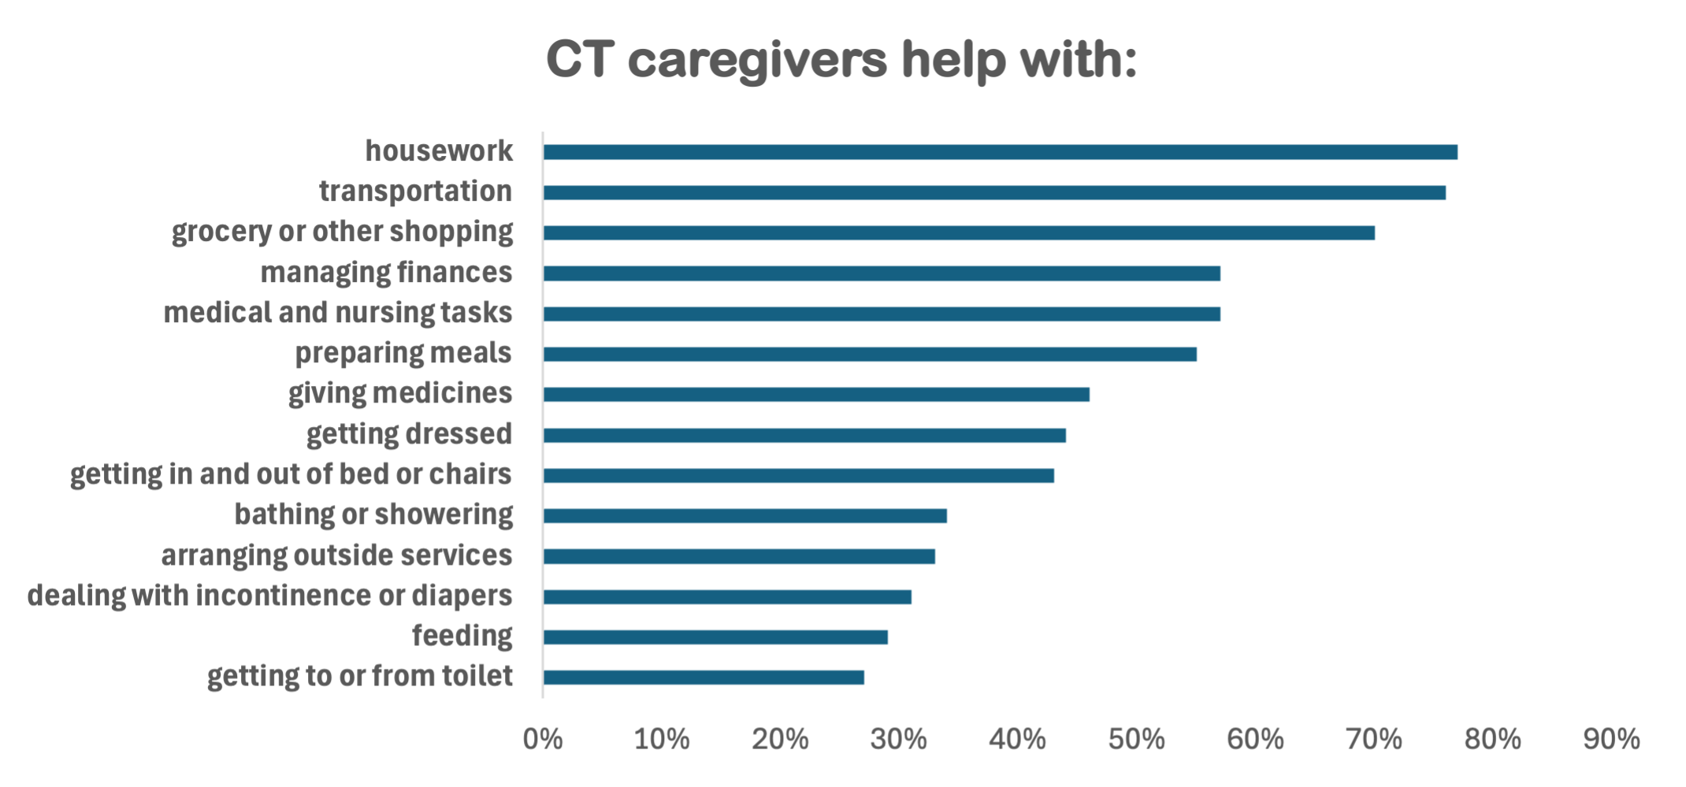
Caregiving qualification
Regular, ongoing care for someone who cannot care for themselves alone
Includes seniors, medical problems, mental health issues
Relative, living with the person, or provide 80 hours of care/month
If <80 hours, it can combine with work, school, or volunteer hours
HUSKYcaregivers.org

Slide 12
Medical frailty exemption
People with serious medical problems and cannot work
Such as -- blind or disabled, alcohol/substance use disorder, disabling mental condition, disability, or serious/complex medical condition
PLUS
Condition must keep you from being able to work
DSS will qualify many based on medical records
If need documentation, people can self-attest through 2027
Lawsuit by states pending, includes CT

Slide 13
How to keep everyone covered
Update your contact info
Find out if you are affected
Respond to DSS messages quickly
Tell people about this
Update income with DSS

Slide 14
For help
Community Action Agency of New Haven
419 Whalley Ave, New Haven
203-387-7700
Access Health CT
Accesshealthct.com
1-855-805-4325
New Haven DSS office
50 Humphrey St., New Haven
1-855-626-6632

Slide 15
Helpful resources
HUSKYcaregivers.org
MedicaidMattersCT.org, DSS
HUSKY D messaging toolkit, CT Hospital Association
Volunteer Community Connection Center
Many thanks to CT Dept. of Social Services, the CT Hospital Association, and the National Health Law Program for their resources and feedback.

Slide 16

Questions

